Slide 1

University Model: Performance measurement
Team Members :
Amisha Gupta
Juhi Kumari
Ajinkya Babar

Slide 2

INTRODUCTION
The ranking of universities and the quality of course offered by it is center to any student’s aspirations. The rankings of education programs will assist you in finding the right classroom.

Slide 3
PROBLEM STATEMENT
One of the most important determinants of any organization and educational institution's performance is its university recognition.
Looking at the ongoing competition between the universities, it has become necessary for every university to have unique courses along with varied course options to stand out amongst the rest.
The courses offered by the university should be updated according to the current industry trends which is necessary as everything around us is getting advanced day by day and being updated is a major task.

Slide 4
PROBLEM SOLUTION
The primary goal of the model is to create a system that allows students to get a preview of the courses as well as choose courses that are tailored to their interest and research preferences.
The procedure of the model will track each course’s feedback within the system which will automatically determine the course’s rating.
The model will also keep a track of faculty feedback and assist the administrators in ranking courses and implement innovative course structures for better results.
The model measures each student’s overall achievement over 5-year period as well as data on which courses affected their progress in order to rate courses based on the satisfaction of the students’ who took that subject.
Hence, with proper statistics such as popularity of course, employment prospects, faculty rating, alignment of courses with industry trends, professional growth of an individual over a span of 5 years after taking this course etc. can help in performance measurement.

Slide 5
To calculate course ranking:
Course Ranking can be determined by class course offer and seat assignment. getcourseRanking() is a method in class course offer which ranks the course offered according to course feedback and faculty rating.
Course score = (sum of all graduate scores in the course) / (number of graduates in the course * ((Course_Rating + Relevant_CourseRating + Helpful_Course / 3));

Slide 6
Calculate faculty rating :
The attribute for faculty evaluation can be added in course offer class where we are assigning a seat to a student in course through assignemptySeat().Course offer class contains details of faculty assigned for that course. Whenever, we will assign seat to student in course offer class, the student gets to evaluate the faculty. Afterwards, the final faculty rating can be calculated by iterating over rating given by all the students and taking the average.

Slide 7
Calculate growth of student over 5-year period
Get the GPA of student : Transcript class has a record of all the courses taken by the student. We can retrieve all course load objects to find GPA. For this, define a method named calculateGPA() in transcript class which will iterate through all courseload objects and get the seat assignment. For a given seat assignment get course grade. Total all the grades and take average. In the student profile class create a reference to transcript instance and define a method named getGPA() which will call the CalculateGPA method.
Alumni Information : We can create a function named sendGoogleForm() for Admin to track the progress of student and get feedback after students graduated in which every year admin can send a google form to alumni in bulk which will include information such as current employee status, number of promotions received, job satisfaction, current salary, rate the courses based on relevance of the job.

Slide 8
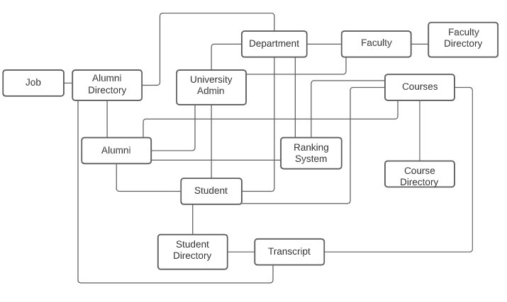
OBJECT MODEL

Slide 9
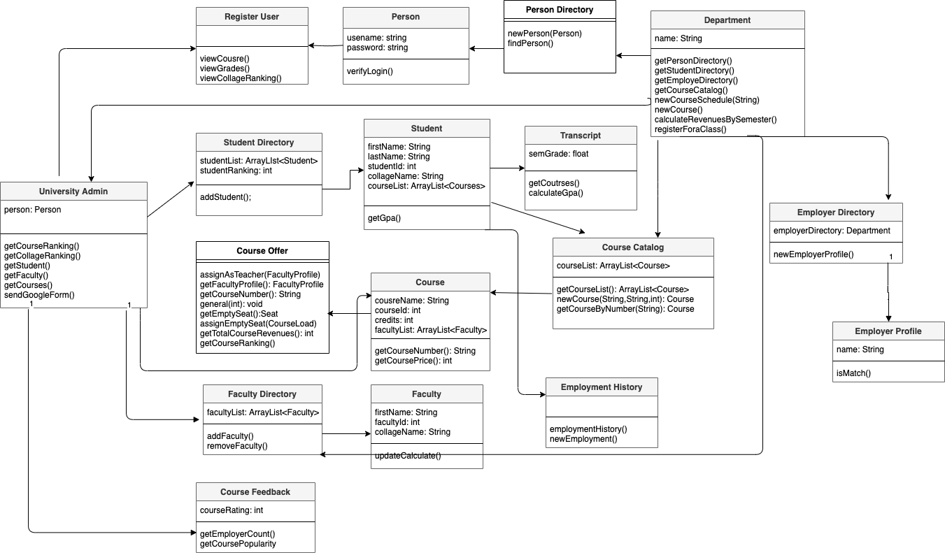
CLASS DIAGRAM

Slide 10
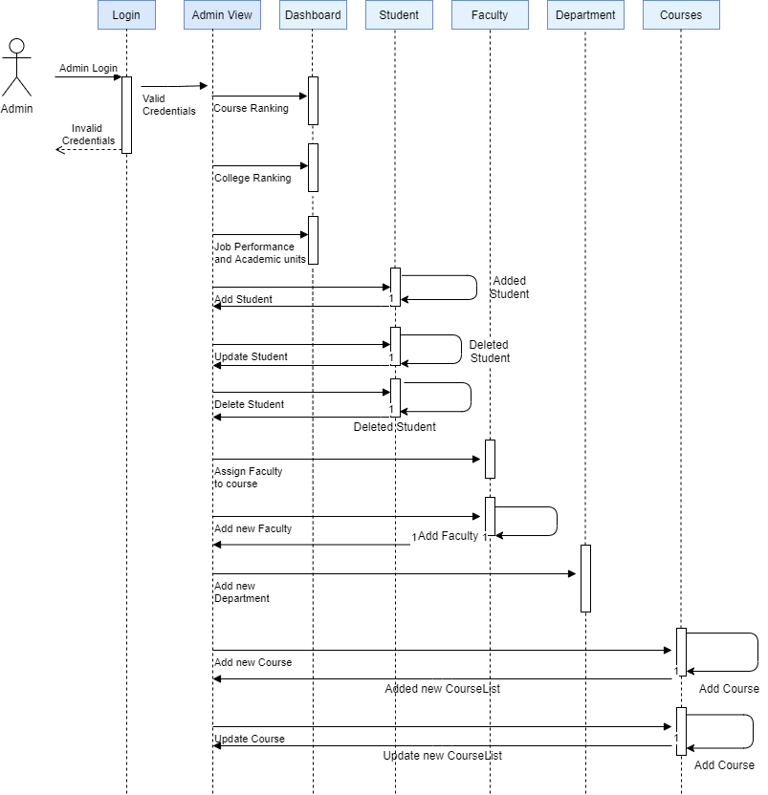
SEQUENCE DIAGRAM ADMIN

Slide 11
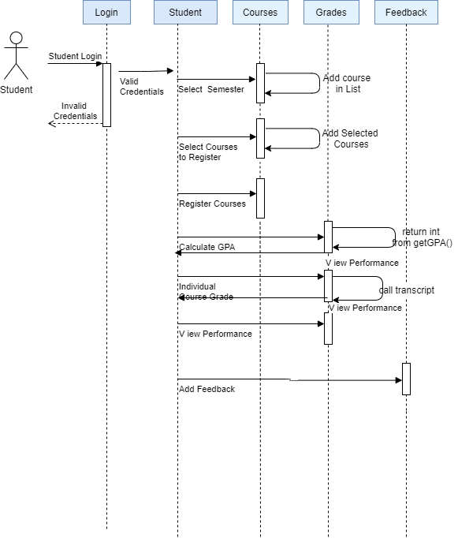
SEQUENCE DIAGRAM STUDENT

Slide 12
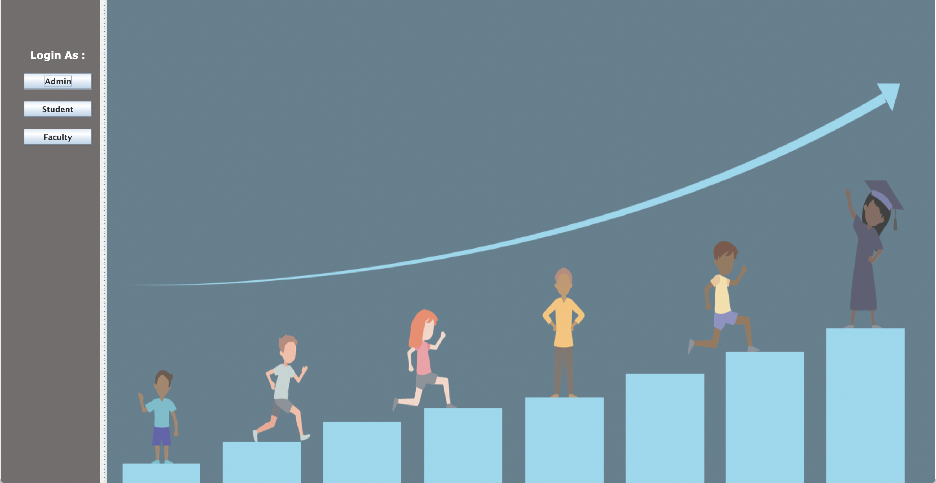
GUI REPRESENTATION

Slide 13
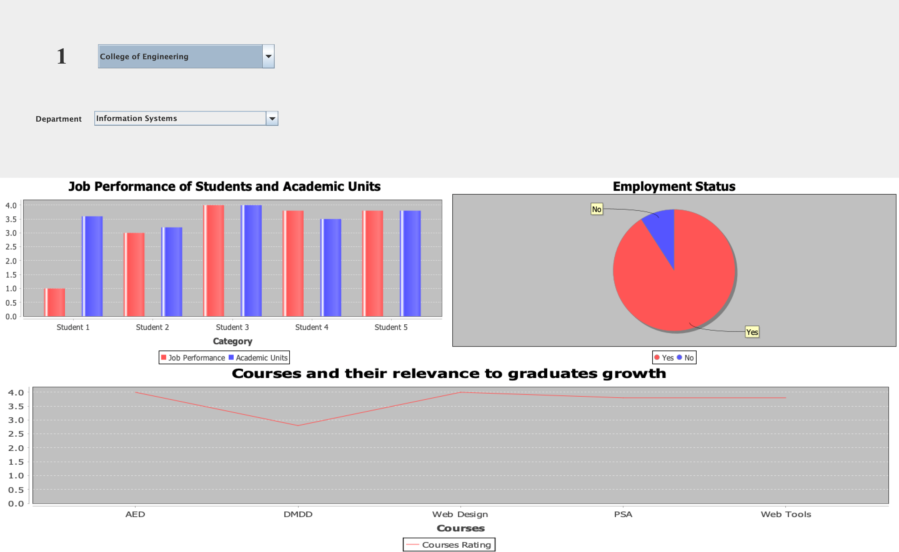
Admin Dashboard

Slide 14
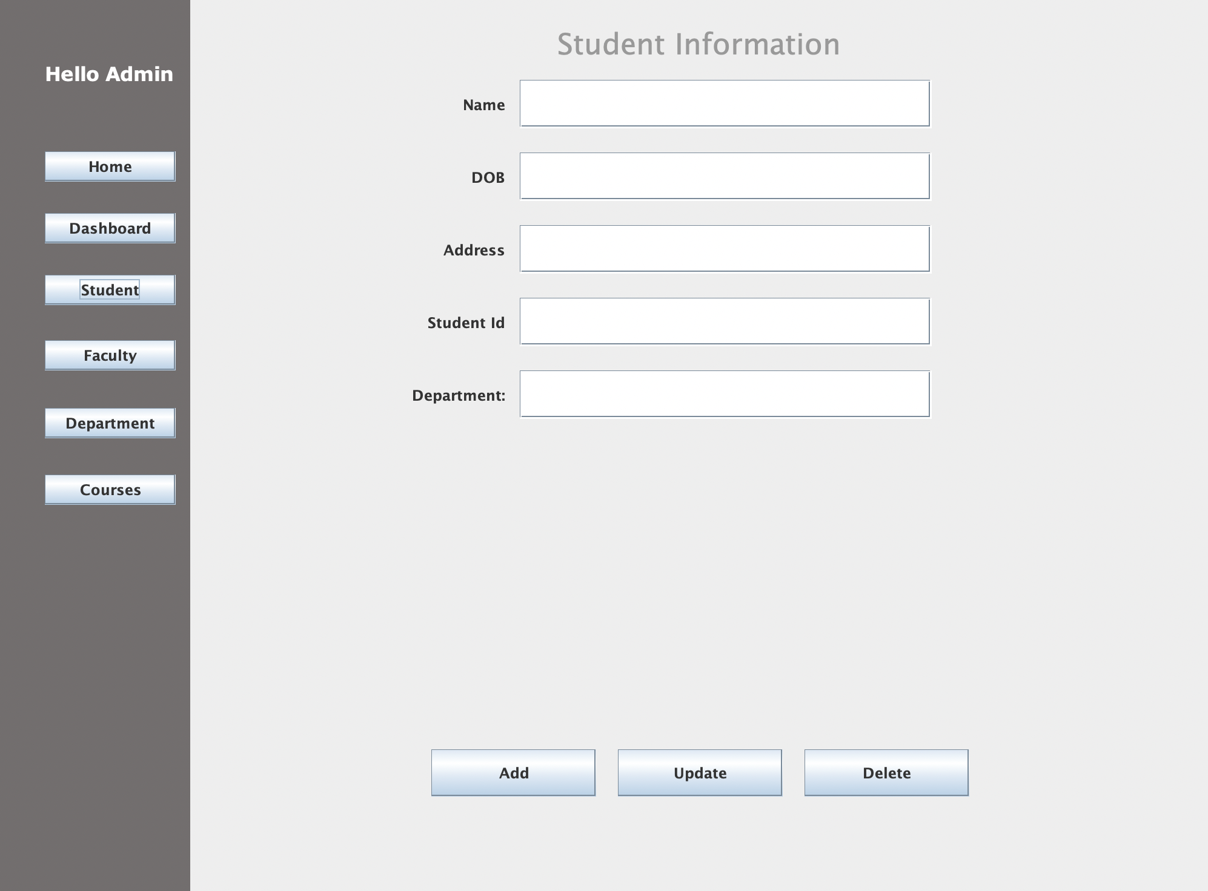
Admin – Student Tab

Slide 15
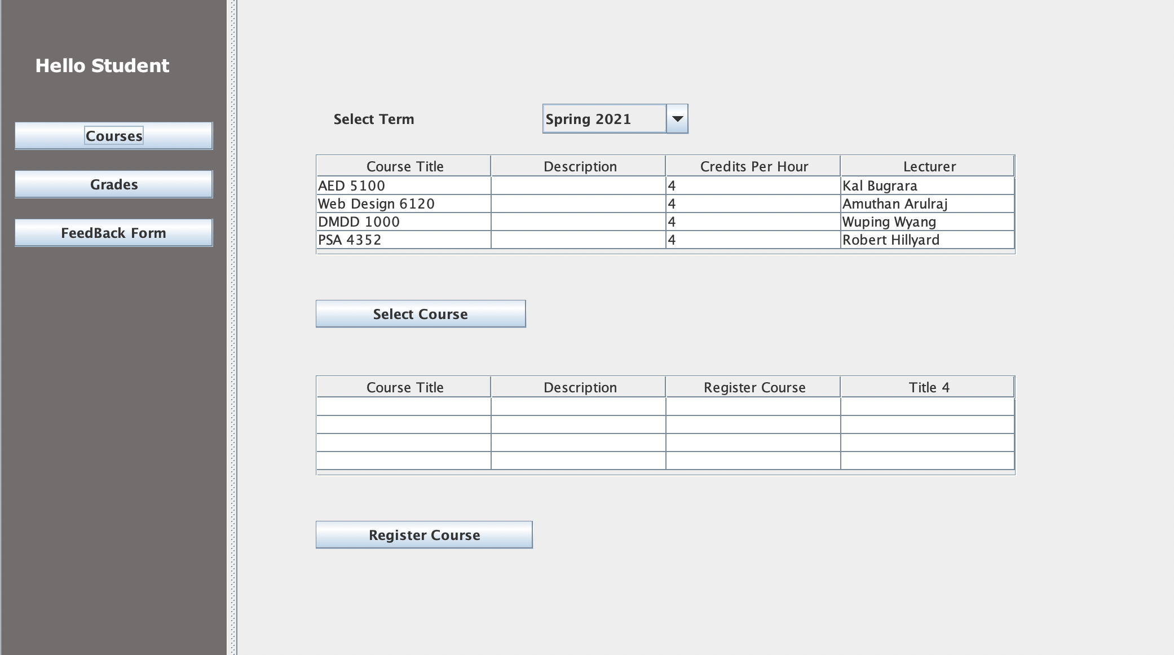
Student View – Register for courses

Slide 16
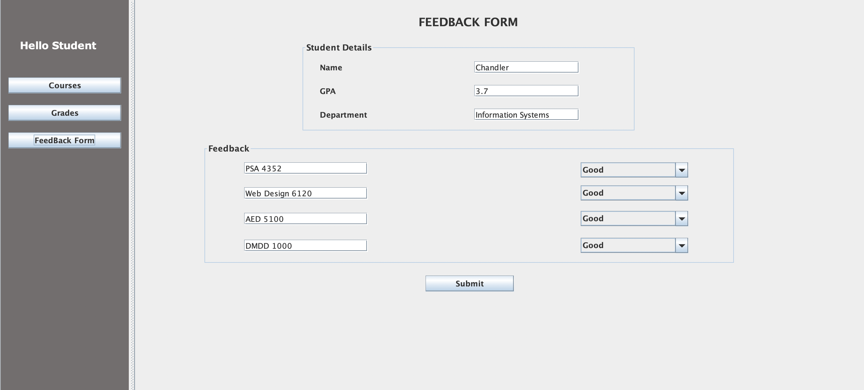
Student View- Grades

Slide 17
CONCLUSION:
Universities lack a performance measurement solution to assess the quality of education they provide to their students. One criterion was to examine the educational system in terms of faculty and courses, as well as how they contributed to the growth of their graduates over a 5-year period. Tracking the graduates' jobs and promotions also provided insight into their development. We were able to provide a solution for the performance measurement solution and define the ranking system of educational institutions, particularly for the developing world, by keeping all of this data and criteria in mind.

